Slide 1
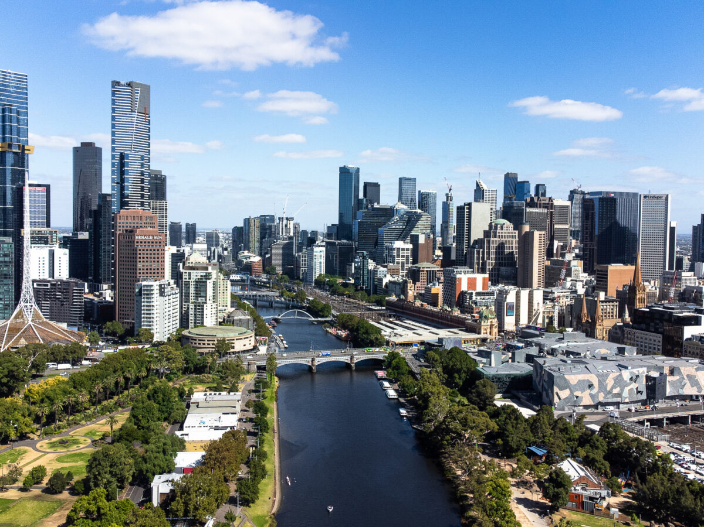
The Complex Interaction of Transport and Land Use in Planning for Melbourne’s Rapid Population Growth.
(Success is not guaranteed)
2023 Ogden Transport Lecture
Monash University, Melbourne,
November 10, 2023
Eric J. Miller, Ph.D.
Prof. Dept. of Civil & Mineral Eng.
Director, Mobility Network
University of Toronto

Slide 2
Cities are systems of systems
Physical (non-biological) world
Cities are complicated systems of interacting systems:
  Economic.
  Social.
  Political.
  Health.
  Technical:
    Transport.
    Information.
    Energy.
    …
They are embedded within even more complex biological & physical worlds.
Biological world (living ecosystem)
(includes COVID-19!)
Human Systems
Political
(power, “taking”)
Social
Economic
(money, “trading”)
Technological
(applying energy)

Slide 3
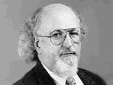
System of Systems: The Urban Activity and Transport Systems
The transport system “mediates” between all activities in space, influencing land development, the location choices of households, firms & other activities.
The distribution of people, businesses & activities, in turn, drives the demand for transport.
“Transport 101”
URBAN ACTIVITY SYSTEM
TRANSPORTATION SYSTEM
Land
Development
Transportation
Network
Location Choice
Automobile
Ownership
Activity
Schedules
Travel Demand
Activity Patterns
Network Flows
Manheim, M.L. (1978) Fundamentals of Transportation Systems Analysis Volume 1: Basic Concepts, MIT Press
(Meyer & Miller, 1984, 2001, 2013)

Slide 4
Current Urban Form (3)
We still walk for short distance trips (where walking is feasible given the street design, etc.).
Public transit still exists, albeit in a substantially reduced role in most cities relative to its hey-day.
The modern city, however, is primarily an automobile-based city, with the vast majority of trips being made each day by car and its urban form, which is both driven by and supportive of the auto-based transport network.
So, what’s the problem with this?

Slide 5
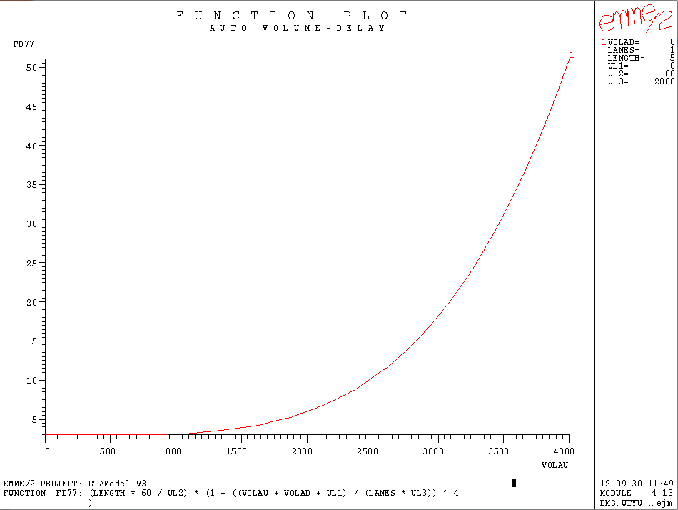
I.e., road-based transport does not scale well as cities grow in size.
Over & above environmental, equity and land use impacts, roadways become very inefficient means of moving people as they become increasingly congested.
Increasing delay
Travel time (minutes)
Increasing congestion
“Free flow” travel time
Capacity
Roadway traffic volume (cars/hour)

Slide 6
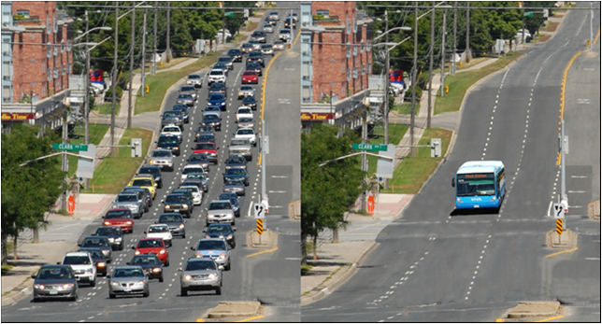
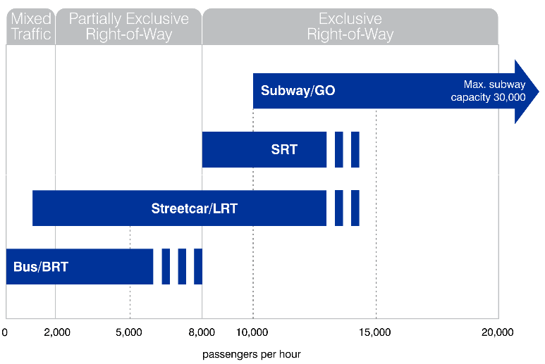
Public Transit
Public transit can be much more efficient in carrying large volumes of people.
The Yonge St. subway in Toronto has a capacity of up to 35,000 persons/hour/direction. This is the equivalent of 14 lanes of highway!
Capacity of a lane of cars

Slide 7
Not everyone needs to take transit.
Cars will remain a major means of travel.
One doesn’t have to divert too many trips from car to other modes of travel under congested conditions to make a big difference in roadway performance.
Large change in travel time
Small change in volume

Slide 8
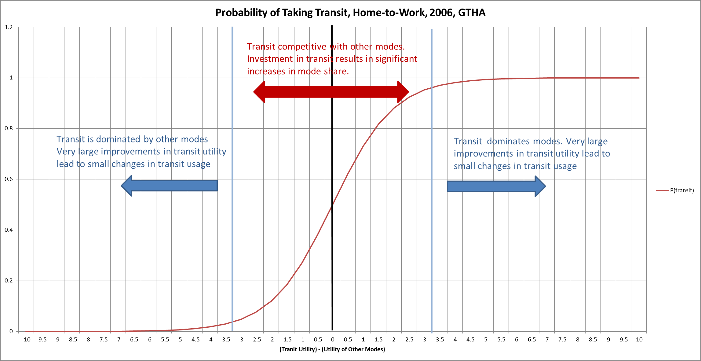
The challenge is to build a transit system that is sufficiently competitive with the automobile to provide an attractive alternative, in a cost-effective manner.

Slide 9
But, transit demand & supply depend fundamentally on urban form, notably density:
Daily Route Ridership
Transit usage depends on many factors.
But it increases with transit supply (level of service).
It also generally increases non-linearly with density.
The supply of service depends on expected demand.
Transit Ridership & Service Supply - Demand Relationships
(adapted from Gonzales [1980])
No. of Daily Bus Runs
S
D1
D2
D3
D4
Urban form determines what is possible to achieve by transit.

Slide 10
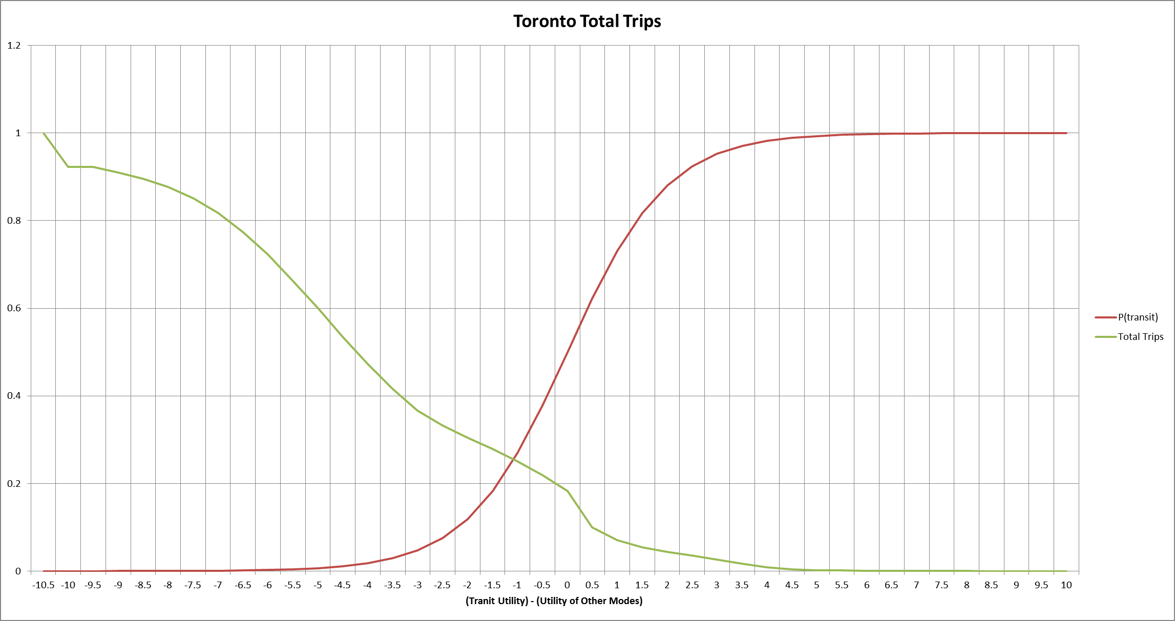
Unfortunately, Toronto is typical of most modern cities in that a considerable majority of trips are made under conditions that are not transit-supportive.
Transit also does not scale as cities grow large, unless urban form enables it to do so.

Slide 11
A Third Revolution?
If Melbourne is to double in size in the next 30 years, the “Business-As-Usual” (BAU) trend of the past decades is NOT sustainable.
We need a “third revolution” in how we build our cities and in how we travel within them.
System Measures:
Vehicle-kilometres travelled
Greenhouse Gases
Congestion/Delay
…
Unacceptable:
Environmental disaster
Economically uncompetitive
Degraded quality of life
Trend
Projection
X
A new path into the future is essential for sustainability:
Environmentally
Economically
Socially
Historical
Trend
Time
Base
Year
Forecast
Horizon

Slide 12
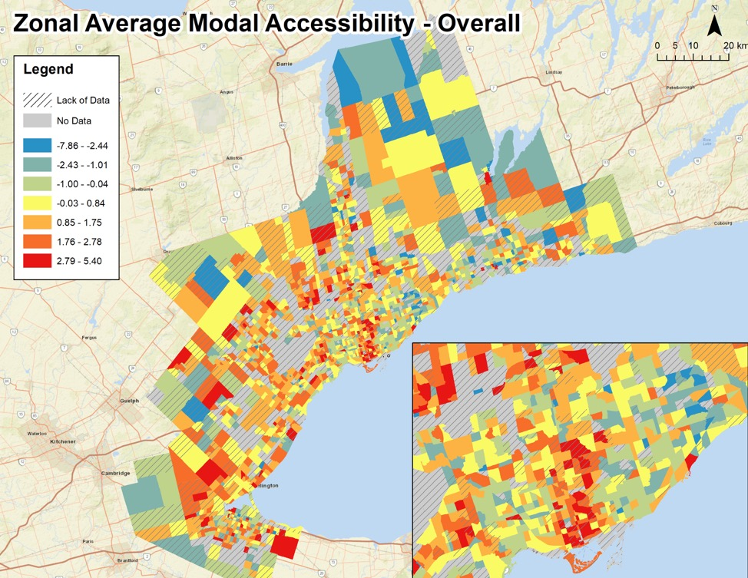
Mobility vs. Accessibility
Historically transportation planning has focussed on improving mobility:
  Travel time reductions.
  Maximizing flows.
We should, instead, focus on improving accessibility: the ability to interact.
Again, this requires an integrated approach to land use & transport.

Slide 13

Sustainable Transport
ENVIRONMENT
“The Four Pillars of Sustainable Urban Transportation”, Kennedy, et. al (2005)
ECONOMY
SOCIETY
A sustainable urban transport system must be built upon four pillars:
Good governance
Adequate & sustainable financing
Sound infrastructure
Good urban form and neighbourhood design
S
S
S
U
U
U
T
T
T
I
I
I
N
N
N
B
B
B
B
B
B
N
N
N
T
T
T
N
N
N
O
O
O
T
T
T
T
T
T
I
I
I
O
O
O
N
N
S
N
S
S
A
A
A
A
A
A
L
L
L
E
E
E
U
U
U
R
R
R
A
A
A
R
R
R
A
A
A
S
S
S
P
P
P
R
R
R
A
A
A
GOVERNANCE
FINANCING
INFRA
-
NEIGHBOUR
-
STRUCTURE
HOODS

Slide 14
Building blocks of the third revolution
Societal Goals
Public Transit
Integrated
Planning
Technology
Equity
Sustainability
Efficiency
Robustness
….
Mobility Services
MaaS
Urban Design
Optimization
Active
Transportation
Complex Systems
Analysis
Policy
PLANING,
ANALYSIS,
EVALUATION
& DESIGN
TOOLS
SERVICES
& SYSTEMS
OUTCOMES

Slide 15
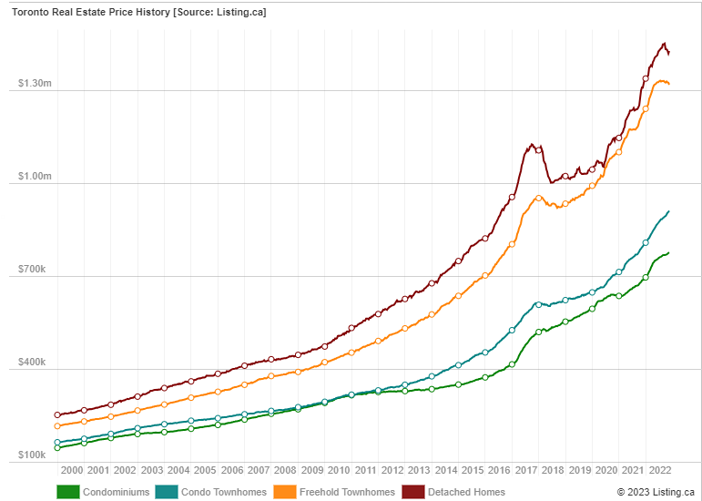
Land Use / Urban Form
Toronto Price History: Average home prices
But it also involves dealing with land economics:
  Affordable housing.
  Affordable commercial real estate.
  Managing the impacts of transport accessibility improvements on land values.
  Transit-oriented design.
  Keeping people & jobs in the city.
  Accessibility for low-income households.
https://toronto.listing.ca/real-estate-price-history.htm

Slide 16
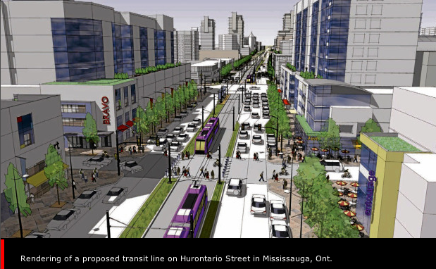
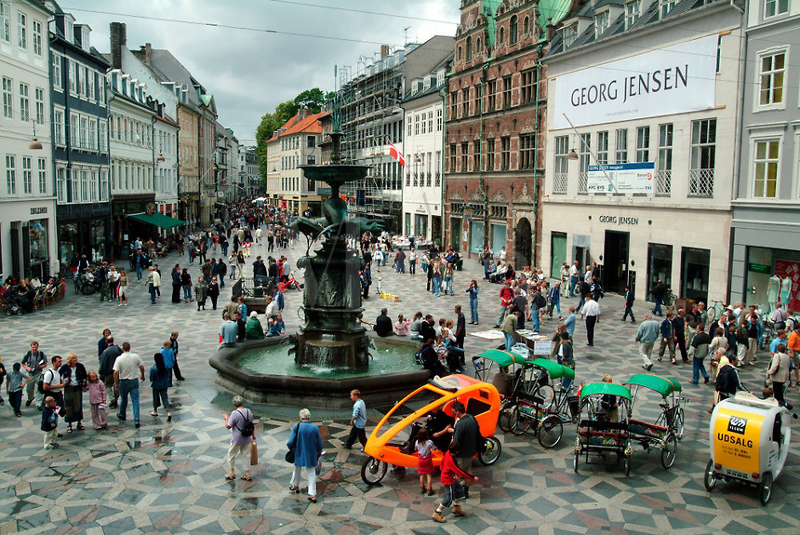
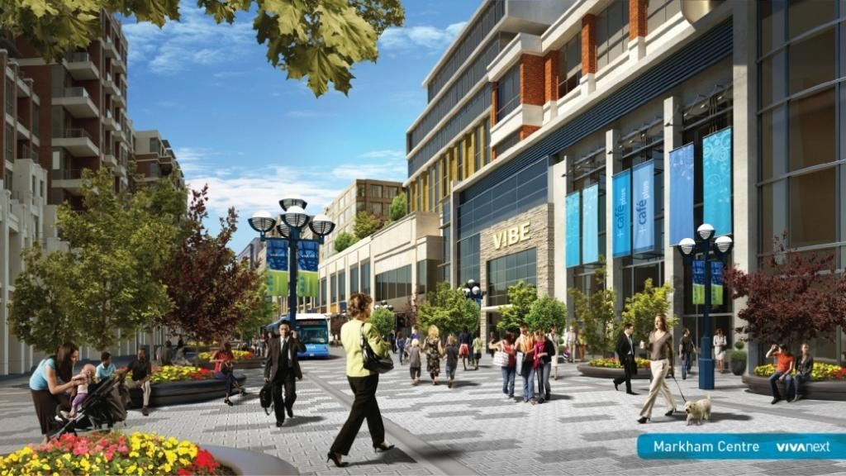
Zurich
Most importantly it must involve a systemic focus on urban & neighbourhood design that integrates land development (housing, commercial uses, services, etc.) with transport (and other infrastructure) supply.
Copenhagen

Slide 17

Radical Incrementalism
Radical incrementalism:
  Look for opportunities for infill.
  Complete communities, where it makes sense.
  TOD, of course, but not 70-storey towers.
  How to change urban form one neighbourhood at a time?
Not every neighbourhood is going to (needs to / can) change.
Each greenfield, brownfield & infill development should “land lightly” on the urban fabric & transport network.
Transport & housing always need to be considered together.
  Where is the transit?
  Walkability?
  Reducing (not eliminating) car dependency.
Is it affordable?

Slide 18
And, a final word …
“Complete communities” / “15-minute cities” are one starting point for this discussion. But:
  These are new labels for ideas that have been around for decades (at least).
Need a systems approach.
Need to recognize:
  The “realities on the ground”.
    Political.
    Economic.
    A huge investment in existing buildings, infrastructure, etc.
  Scalability at the regional level.
  Practical pathways from “here” to “there”.
Demographics
Land Use
Economy
Transportation
+
-
Accessibility
Mobility
Productivity
Quality of Life
-
Congestion
Pollution/GHG
Accidents
Loss of Land

Slide 19
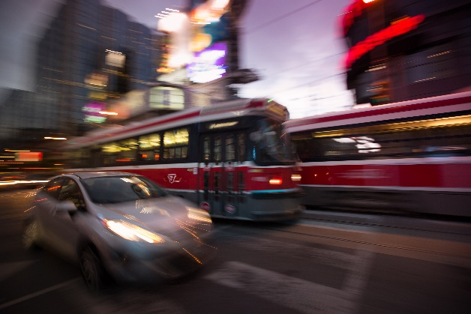
Thank you for your attention.
Let’s discuss!

